Slide 1
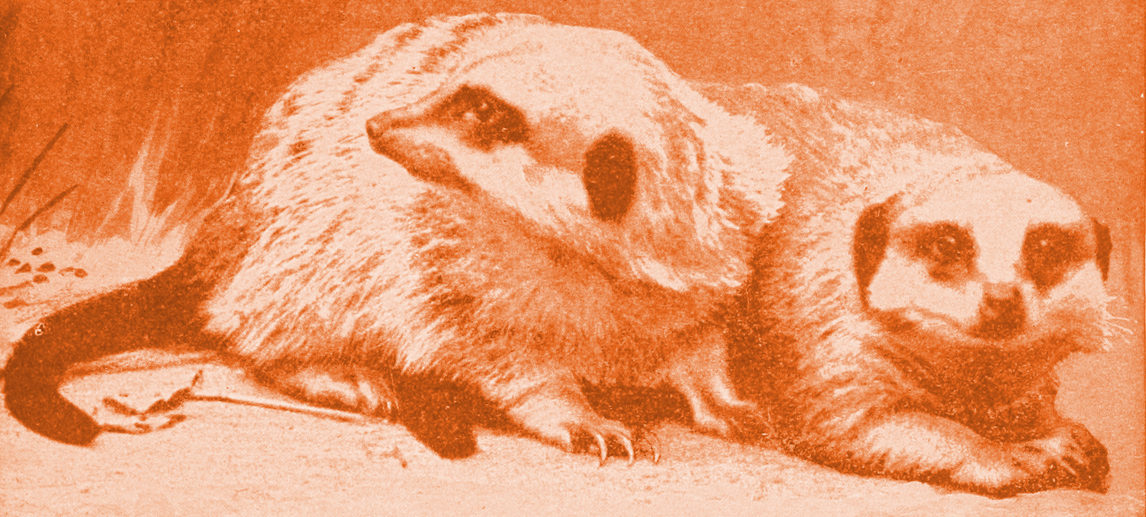
Meerkat system training
Data Storage Solutions
Jyri Soppela
01/03/2017

Slide 2
Contents
1. Introduction
2. Section 1
  2.1 First topic
  2.2 Second topic
3. Exercise
  3.1 Problem 1
  3.2 Problem 2
6. Additional training material

Slide 3
1. Introduction
Main aim of the Meerkat system is to provide fast public health surveillance
There are several data sources:
  ODK form data
  Location and clinic data
  Mobile device data
  Variable data to calculate standardized variables based on raw data from ODK
These data sources have slightly different data structure requirements
The system uses several technologies for data storage and transfer:
  Flat files
  Relational Database: PostgreSQL
  JSON databases: PostgreSQL and Amazon DynamoDB

Slide 4
Data types – Comma Separated Value
trainee_name | trainee_role | session_number | session_date | session_subject | trainer_name | trainer_email
Fred | DBA | 1 | 01/03/2017 | SQL | Rawand | rawand@sql.org
Farhan | Manager | 1 | 01/03/2017 | SQL | Rawand | rawand@sql.org
Yara | Developer | 1 | 01/03/2017 | SQL | Rawand | rawand@sql.org
Fred | DBA | 2 | 02/03/2017 | Python | Sven | sven@python.org
Yara | Developer | 2 | 02/03/2017 | Python | Sven | sven@python.org
Flat files are easy to edit and display
A good selection of software handles them: Excel, OpenOffice and LibreOffice all have spreadsheet capabilities and support the CSV format
Flat files need to be validated to avoid conflicting data
Relationship visualization is challenging

Slide 5
Data types – Relational database tables
Attendance
Trainee
Id | Session_id | Trainee_id
1 | 1 | 1
2 | 1 | 2
3 | 1 | 3
4 | 2 | 1
5 | 2 | 3
Id | Name | Role
1 | Fred | DBA
2 | Farhan | Manager
3 | Yara | Developer
Session
Trainer
Id | Date | Subject | Trainer_id
1 | 01/03/2017 | SQL | 1
2 | 02/03/2017 | Python | 2
Id | Name | Email
1 | Rawand | rawand@sql.org
2 | Sven | sven@python.org

Slide 6
Data types – Relational database tables
Relational databases must be accessed via database clients
Capacity is much higher than with flat files as the whole data set is not loaded to memory
Relational table structure enforces the data format
Data model maps out relationships and reduces conflicts in the data
Relational databases are usually used via a language called Structured Query Language (SQL)
A sample SQL data query:
    SELECT NAME what data fields to get?
    FROM TRAINEE where to get it from?
    WHERE ROLE = ‘DBA’; which rows to return?

Slide 7
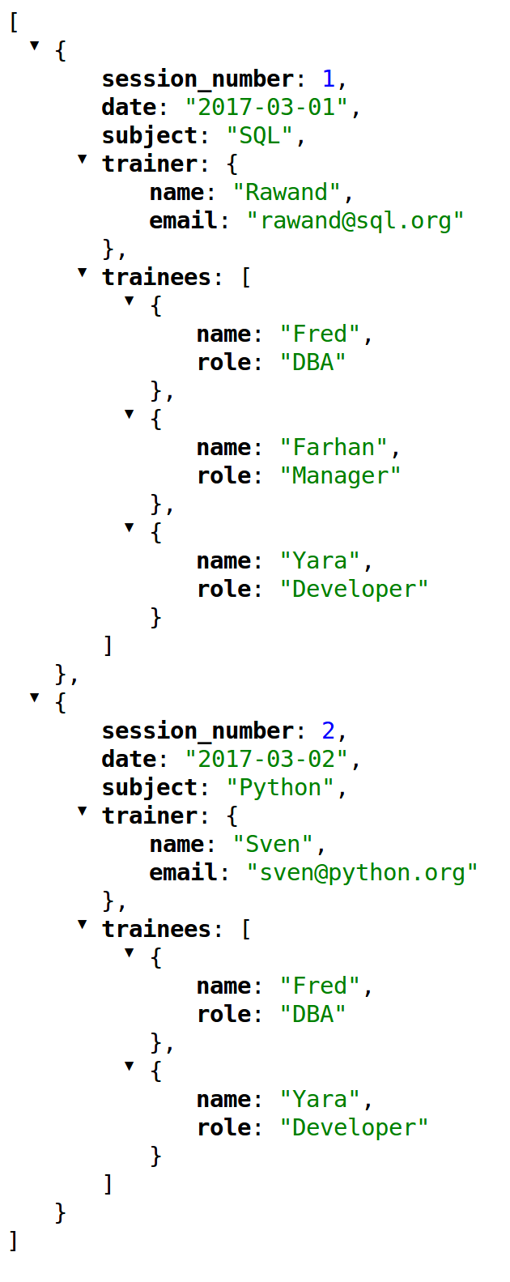
Data types – JSON objects
JSON means JavaScript Object Notation even though it is used also outside JavaScript
JSON objects consist of key-value pairs and ordered lists
JSON objects can be nested
Changing the structure of JSON objects does not require changes in the database structure
Extremely high capacity databases use JSON structure but our usage is no where near this scale
Mapping relationships is not as easy as with relational databases

Slide 8

PostgreSQL
PostgreSQL is an open source relational database
In additional to standard SQL operations, PostgreSQL can store and query JSON objects
JSON objects are stored in a separate JSON data type
JSON operations are used as an extension to the SQL standard
Other extensions of PostgreSQL include GIS location data and a text mining module

